Slide 1

OGSA Workflow Design Team
OGF21

Slide 2

OGF IPR Policies Apply
“I acknowledge that participation in this meeting is subject to the OGF Intellectual Property Policy.”
Intellectual Property Notices Note Well: All statements related to the activities of the OGF and addressed to the OGF are subject to all provisions of Appendix B of GFD-C.1, which grants to the OGF and its participants certain licenses and rights in such statements. Such statements include verbal statements in OGF meetings, as well as written and electronic communications made at any time or place, which are addressed to:
    the OGF plenary session,
    any OGF working group or portion thereof,
    the OGF Board of Directors, the GFSG, or any member thereof on behalf of the OGF,
    the ADCOM, or any member thereof on behalf of the ADCOM,
    any OGF mailing list, including any group list, or any other list functioning under OGF auspices,
    the OGF Editor or the document authoring and review process
Statements made outside of a OGF meeting, mailing list or other function, that are clearly not intended to be input to an OGF activity, group or function, are not subject to these provisions.
Excerpt from Appendix B of GFD-C.1: ”Where the OGF knows of rights, or claimed rights, the OGF secretariat shall attempt to obtain from the claimant of such rights, a written assurance that upon approval by the GFSG of the relevant OGF document(s), any party will be able to obtain the right to implement, use and distribute the technology or works when implementing, using or distributing technology based upon the specific specification(s) under openly specified, reasonable, non-discriminatory terms. The working group or research group proposing the use of the technology with respect to which the proprietary rights are claimed may assist the OGF secretariat in this effort. The results of this procedure shall not affect advancement of document, except that the GFSG may defer approval where a delay may facilitate the obtaining of such assurances. The results will, however, be recorded by the OGF Secretariat, and made available. The GFSG may also direct that a summary of the results be included in any GFD published containing the specification.”
OGF Intellectual Property Policies are adapted from the IETF Intellectual Property Policies that support the Internet Standards Process.
Notes:
IPR Notices Note Well for OGF meetings

Slide 3
Outline
Scope
Previous Plans
Workflow Survey

Slide 4
Scope
Error Handling is out of scope
Error detection is in scope
Graph representation SHOULD be out of scope
  Simple collection and declaration is in scope
Cyclic declarations are out of scope

Slide 5
Previous Plans (A)
Extend JSDL, OGSA
    Simple dependency descriptions within JSDL
✗
Are we really the best people to define a new workflow language?
Pre
JSDL
Post
Call out to process
Wait for Call out
Pre
JSDL
Post
Pre
JSDL
Post
Pre
JSDL
Post
Pre
JSDL
Post

Slide 6
Workflow over JSDL (Plan B)
Use of existing workflow languages through OGSA
  BPEL workflow over JSDL
    Would anyone care if we just used BPEL
✗
YES!
There are other languages people want to use
There are some who believe that BPEL model doesn’t
support all use cases we have
(Implicitly) Forces a centralized model

Slide 7
Focus now on Use Cases
Currently a survey of Workflow systems is underway
  First iteration is very simple
  Will ask more ‘in depth’ questions later
Survey to focus on how to combine workflow use within a SOA model
  Proposal is that the focus should be at integrating workflow at the service level (web 2.0 style for example) and the internals of the composed services are just a blackbox
  Grand unification (of workflow languages) is not the goal

Slide 8
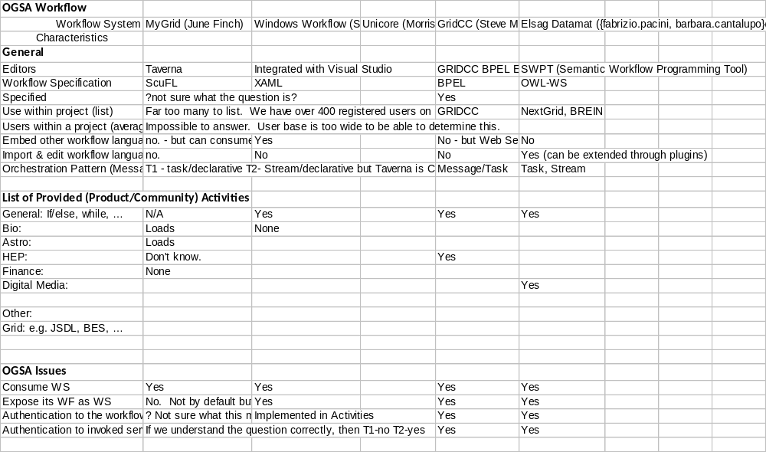
Survey

Slide 9
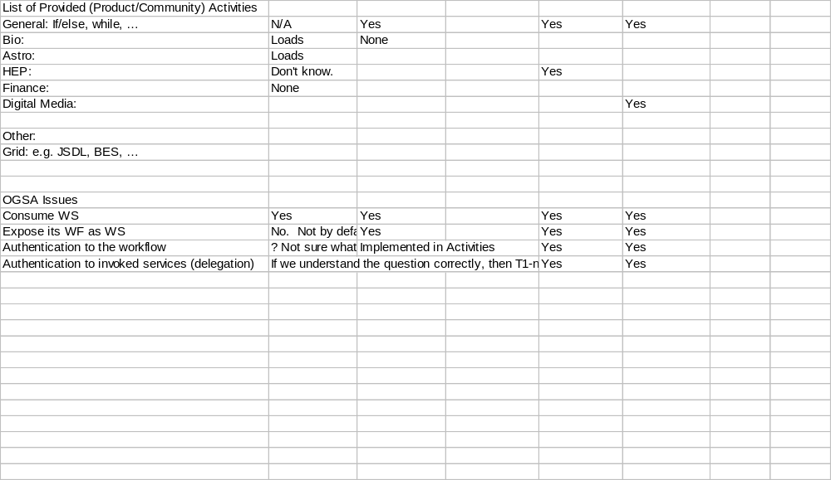

Slide 10
Questions
What should OGSA do to enable workflow?
  What changes are required?
    Security design issues
Do we want workflows to be able to invoke Grid Services?
  And vice versa?
Taking out the implicit workflow from JSDL?
  Stage in > execute > stage out

Slide 11
Full Copyright Notice
Copyright (C) Open Grid Forum (2007). All Rights Reserved.
This document and translations of it may be copied and furnished to others, and derivative works that comment on or otherwise explain it or assist in its implementation may be prepared, copied, published and distributed, in whole or in part, without restriction of any kind, provided that the above copyright notice and this paragraph are included on all such copies and derivative works.
The limited permissions granted above are perpetual and will not be revoked by the OGF or its successors or assignees.
Notes:
OGF Full Copyright Notice if necessary

